Slide 1
Project
Car Rental System

Slide 2
Project Group Members
1. Manish Ramani ramani.ma@northeastern.edu
- GUI: Registration - System Admin with Validation,
Renter - Update Car, Delete Car
Lessee - Car Booking
System Admin - Delete Renter, Delete Lessees
- Implementation of Booking Class Hierarchy with factory design, CarRentalSystemBase Class Hierarchy with Singleton design
- Written the controller methods responsible for the GUI implementation
2. Varad Desai desai.var@northeastern.edu
- GUI: Registration - Lessee and Renter with Validation
Renter - Register Car
Lessee - Update Booking, Delete Booking
System Admin - View Invoice, Delete Booking
- Implementation of Car Class Hierarchy with factory design, Person Class Hierarchy with Renter, Lessee and System Admin with factory design
- Written the controller methods responsible for the GUI implementation
- We had done some parts together by sharing screen
The File I/O - CSV, methods for sorting the lists with Comparator, methods for implementing logic involved (ex - Total fee calculation, adding constraints for disallowing any two lessees to book a same car at the same time, limiting a Lessee to book more than 3 cars at the same time) and powerpoint presentation are done together.

Slide 3
Problem Statement: Car Rental System
1. Register System Admins: PersonId, AdminId, Type, Name, LicenseNumber, DateOfBirth, EmailId, Password
2. Register Renter: PersonId, RenterId, Type, Name, LicenseNumber, DateOfBirth, EmailId, Password
3. Register Cars: CarId, RenterId, Company, Name, NumberOfSeats, InsuranceNumber, RentPerHour
4. Register Lessee: PersonId, LesseeId, Type, Name, LicenseNumber, DateOfBirth, EmailId, Password
5. Once Registered, Renter can Add, Delete or Update Cars to be rented via the application
6. While adding Car, Renter will enter all the details of the Car including its RentPerHour.

Slide 4
Problem Statement: Car Rental System
7. Once Registered, Lessee can login to the system and the Lessee will select the Car for renting.
8. After selecting the car, lessee will enter the Date and Time for which it wants to book the car and will book the car.
9. Fees for the booking gets calculated and the booking is displayed in Lessee’s account page.
10. System Admin has access to all the data of Renter , Renter’s registered cars, Lessees and Lessee’s bookings.
11. System Admin can Remove and View these information if needed.
12. Added a constraint of : - limiting a lessee to book maximum of 3 cars at a time
- no two lessees can book same car for the same time slot.

Slide 5
CAR RENTAL SYSTEM: Design principles
Object Oriented Design Principles:
Abstraction
Encapsulation
Inheritance
Polymorphism
S.O.L.I.D Design Principles:
Single Responsibility
Open/Close
Liskov Substitution
Interface Segregation
Dependency Inversion

Slide 6
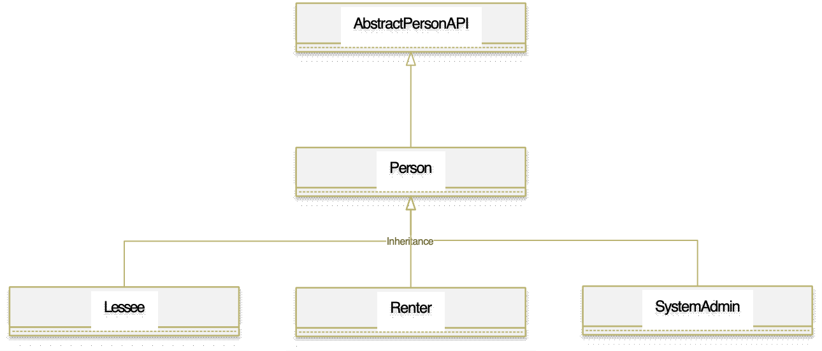
Class hierarchy Diagram

Slide 7
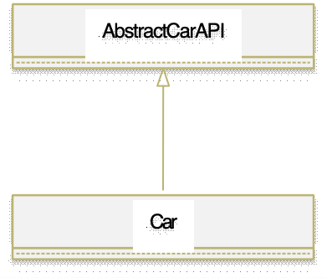
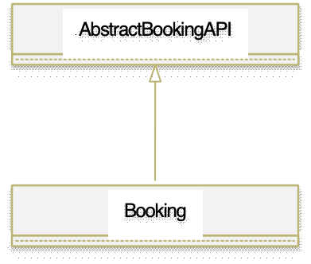
Class hierarchy Diagram

Slide 8
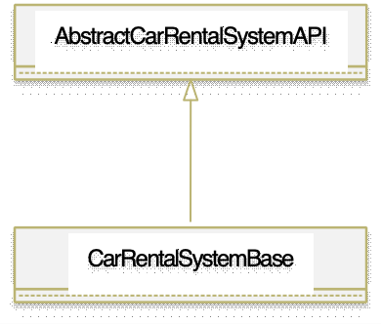
Class hierarchy Diagram

Slide 9
CarRentalSystem: Design Pattern
Singleton Design Pattern
CarRentalSystem
Factory Design Pattern
Lessee
Renter
SystemAdmin
Car
Booking

Slide 10
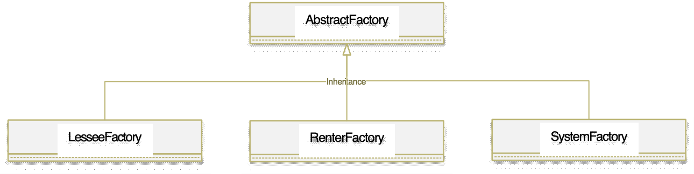
Class hierarchy Diagram:
GoF Factory

Slide 11
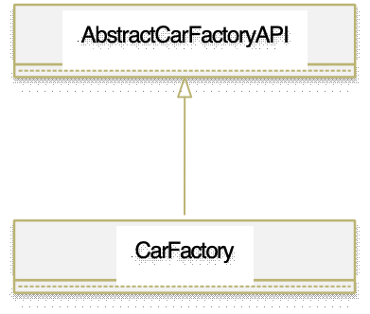
Class hierarchy Diagram:
GoF Factory

Slide 12
Class hierarchy Diagram:
Singleton Design
AbstractCarRentalSystemAPI
returns a new instance of
CarRentalSystemBase when
getObject method is called for
the first time and it returns the
same instance every other time
getObject method is called.

Slide 13
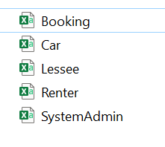
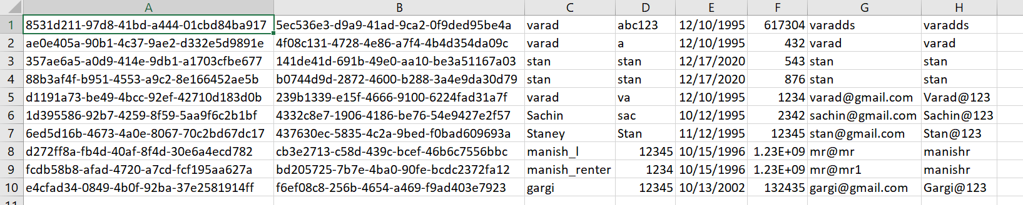
CarRentalSystem: Database
CSV
BufferedReader, BufferedWriter
FileReader, FileWriter
Scanner
Lessee Data

Slide 14
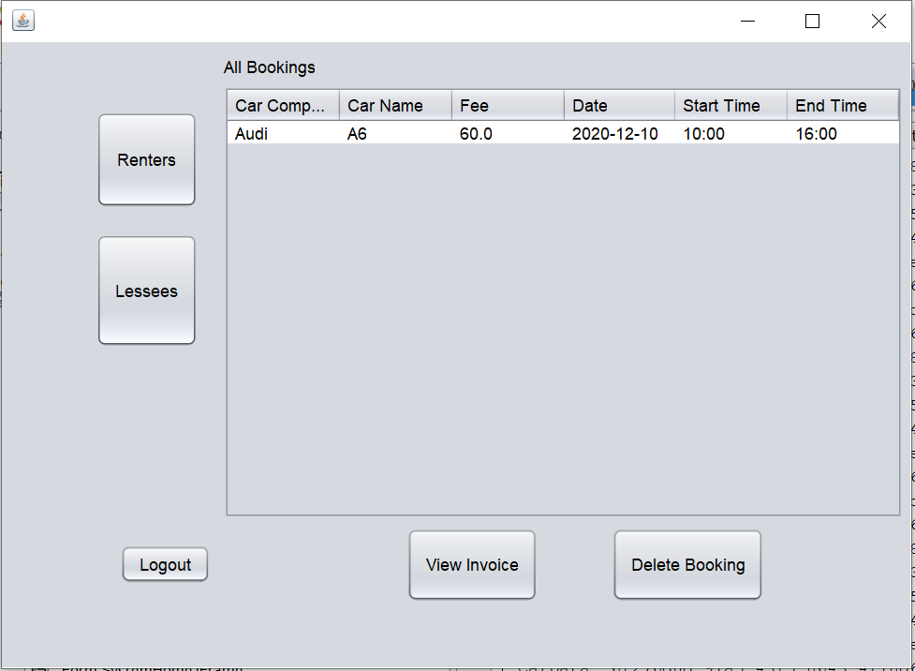
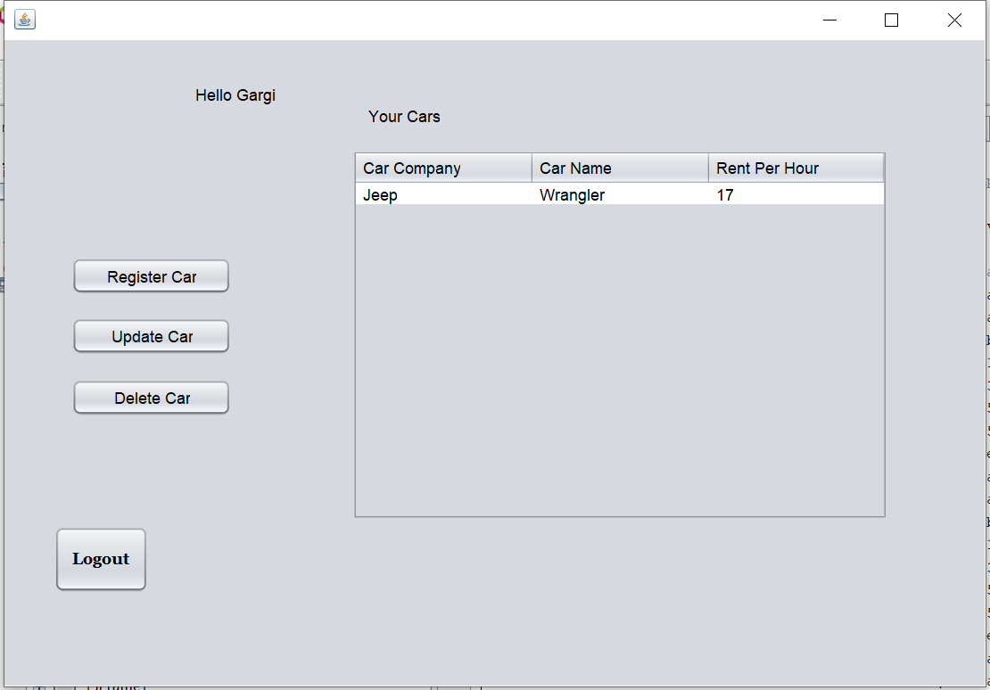
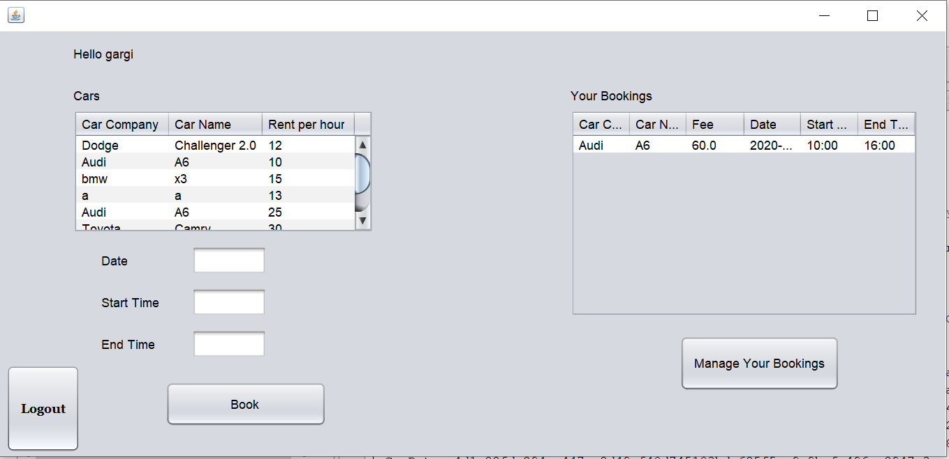
CarRentalSystem: Java 8 Functions
Stream API
Lambda Function
Method Reference

Slide 15
Demo

Slide 16
Thank you

